Slide 1
Detection of Deepfakes Cepstral Analysis
Speech Group 05/06/2024
Anthony White

Slide 2
Synthetic speech detection
Source filter modelling
Bispectral analysis
Now looking into cepstral analysis.

Slide 3
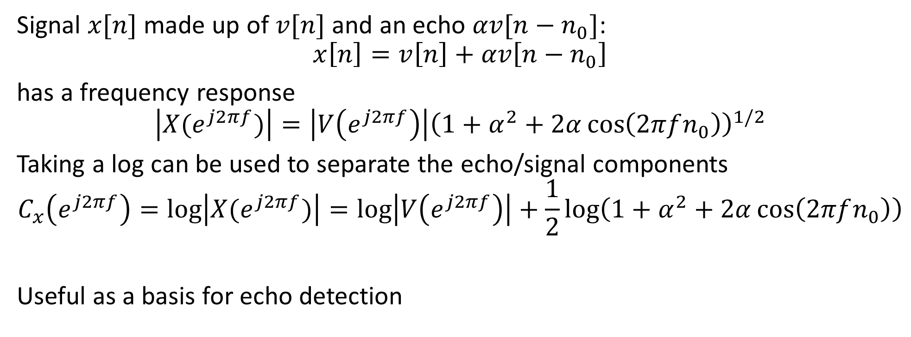
Motivation
Signal $x[n]$ made up of $v[n]$ and an echo $αv[n−n_{0}]$:
$$x\left[n\right]=v\left[n\right]+αv\left[n−n_{0}\right]$$
has a frequency response
$$\left|X(e^{j2πf})\right|=\left|V\left(e^{j2πf}\right)\right|{\left(1+α^{2}+2α\cos\left(2πfn_{0}\right)\right)}^{1/2}$$
Taking a log can be used to separate the echo/signal components
$$C_{x}\left(e^{j2πf}\right)=\log\left|X(e^{j2πf})\right|=\log\left|V\left(e^{j2πf}\right)\right|+\frac{1}{2}\log\left(1+α^{2}+2α\cos\left(2πfn_{0}\right)\right)$$
Useful as a basis for echo detection
signal
echo

Slide 4
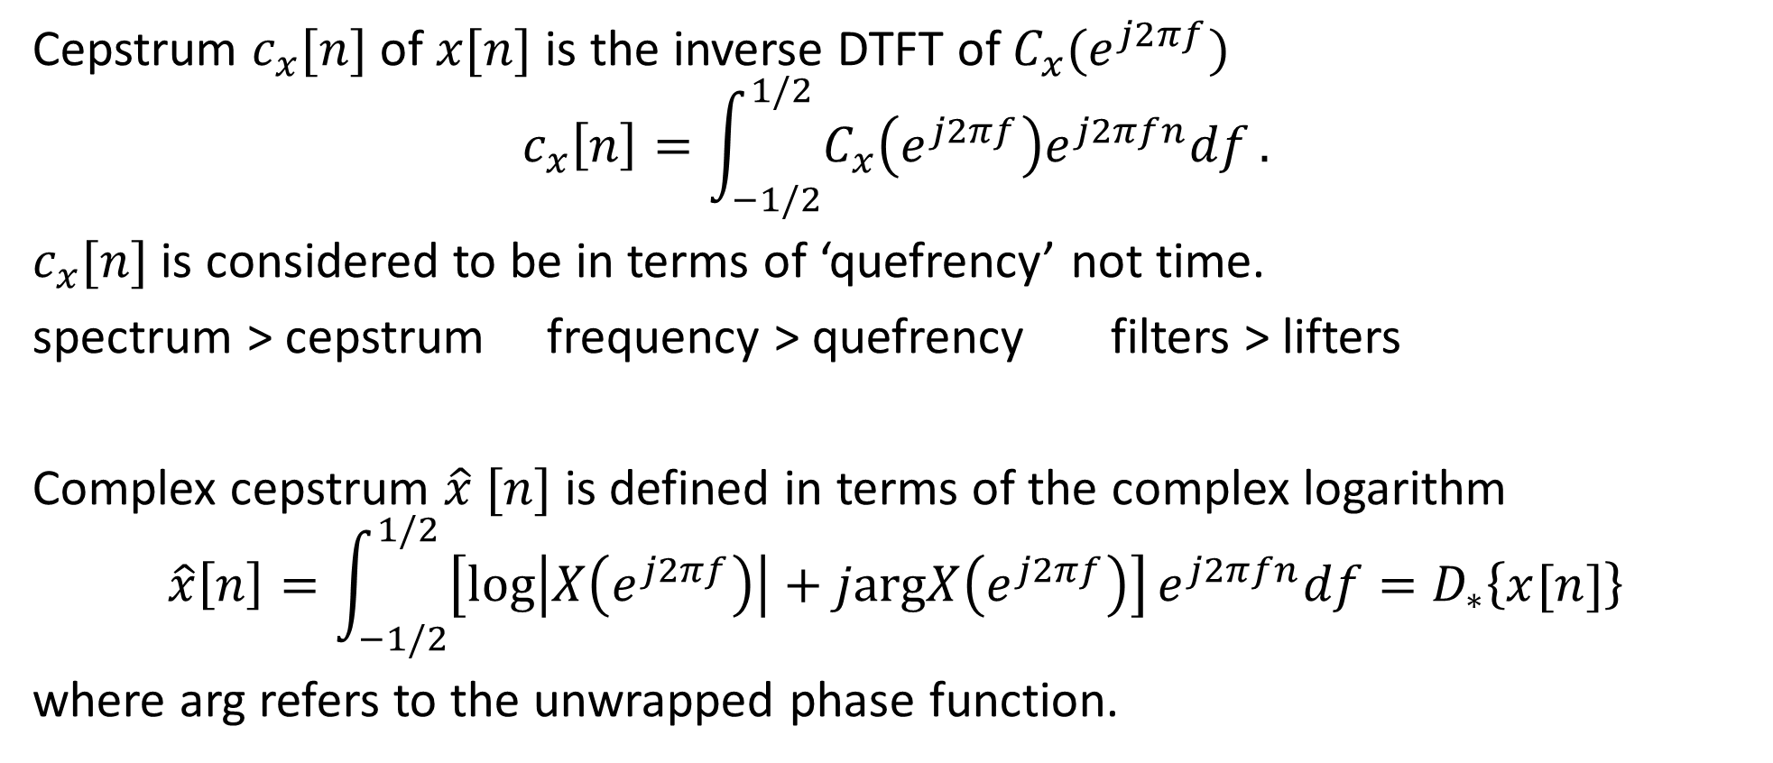
Definition
Cepstrum $c_{x}[n]$ of $x[n]$ is the inverse DTFT of $C_{x}(e^{j2πf})$
$$c_{x}\left[n\right]=\int_{−1/2}^{1/2}{C_{x}\left(e^{j2πf}\right)e^{j2πfn}df}.$$
$c_{x}[n]$ is considered to be in terms of ‘quefrency’ not time.
spectrum > cepstrum frequency > quefrency filters > lifters
Complex cepstrum $\hat{x} [n]$ is defined in terms of the complex logarithm
$$\hat{x}\left[n\right]=\int_{−1/2}^{1/2}{\left[\log\left|X\left(e^{j2πf}\right)\right|+j\text{arg}X\left(e^{j2πf}\right)\right]}e^{j2πfn}df=D_{∗}\left\{x[n]\right\}$$
where arg refers to the unwrapped phase function.

Slide 5
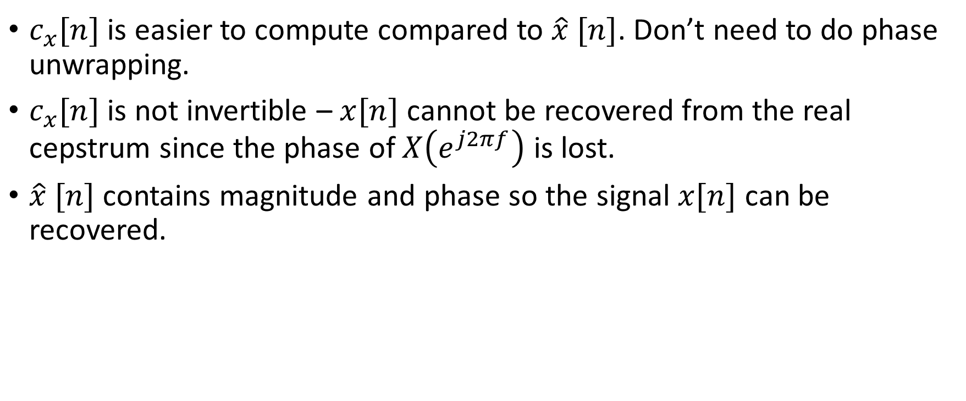
Complex vs. Real Cepstrum
$c_{x}[n]$ is easier to compute compared to $\hat{x} [n]$. Don’t need to do phase unwrapping.
$c_{x}[n]$ is not invertible – $x[n]$ cannot be recovered from the real cepstrum since the phase of $X\left(e^{j2πf}\right)$ is lost.
$\hat{x} [n]$ contains magnitude and phase so the signal $x[n]$ can be recovered.

Slide 6

Convolution
If $x\left[n\right]=x_{1}\left[n\right]∗x_{2}[n]$ then $x\left[n\right]=D_{∗}\left\{x_{1}\left[n\right]∗x_{2}[n]\right\}={\hat{x}}_{1}\left[n\right]+{\hat{x}}_{2}\left[n\right]$
Convolution in time = Multiplication in frequency = Addition in quefrency
Can use this to separate the source and filter using a lifter.

Slide 7
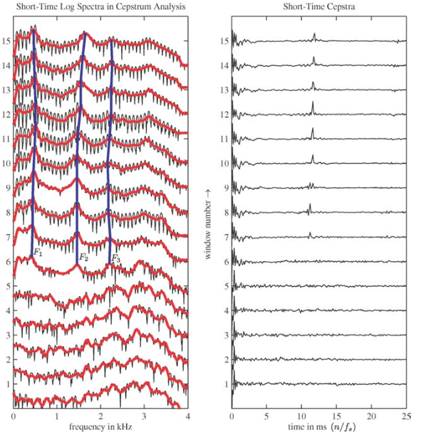
Voice activity detection

Slide 8
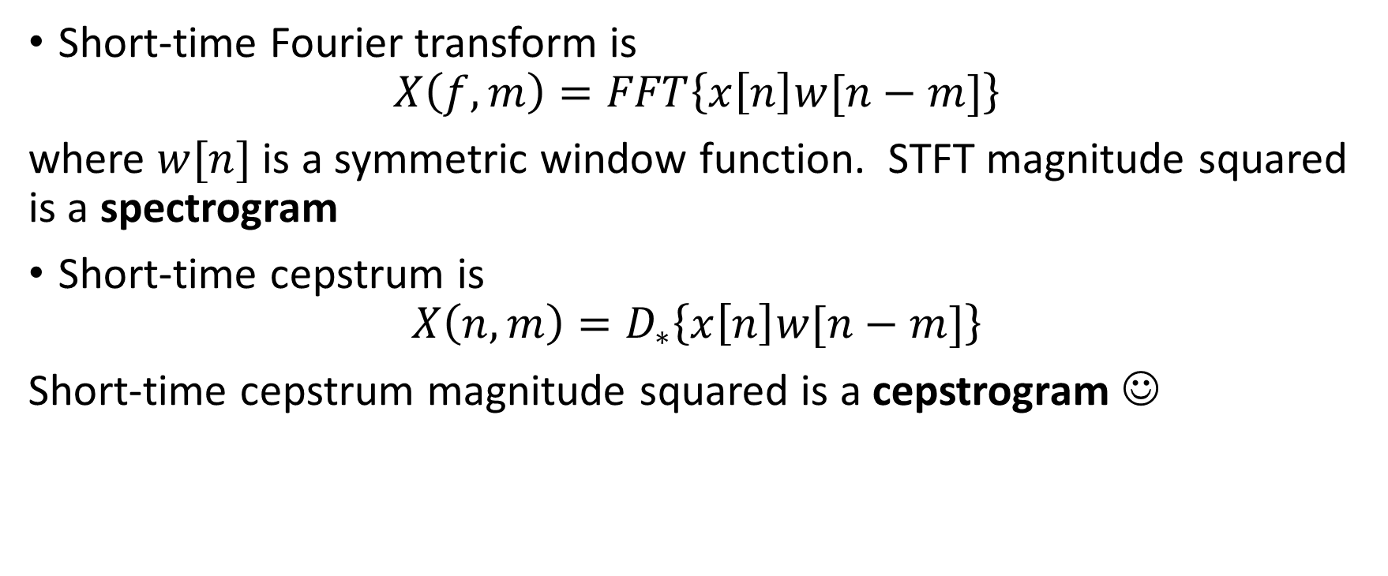
Short-time Cepstrum
Short-time Fourier transform is
$$X\left(f,m\right)=FFT\left\{x\left[n\right]w[n−m]\right\}$$
where $w[n]$ is a symmetric window function. STFT magnitude squared is a spectrogram
Short-time cepstrum is
$$X\left(n,m\right)=D_{∗}\left\{x\left[n\right]w[n−m]\right\}$$
Short-time cepstrum magnitude squared is a cepstrogram ☺

Slide 9
